Slide 1
Facebook Campaign Analysis

Slide 2

Table of Contents
01
02
03
05
Terminology Defining
Examining The Dataset
Campaign Highlights
04
Lookalike vs Detailed Targeting
Various Funnel Metrics Analysis

Slide 3
01
Terminology Defining

Slide 4

The Marketing Funnel
Awareness
Interest
Desire
Action

Slide 5
Audience
Core (Detailed Targeting)
Lookalike
Custom (Hot & Warm)

Slide 6
02
Examining The Dataset

Slide 7
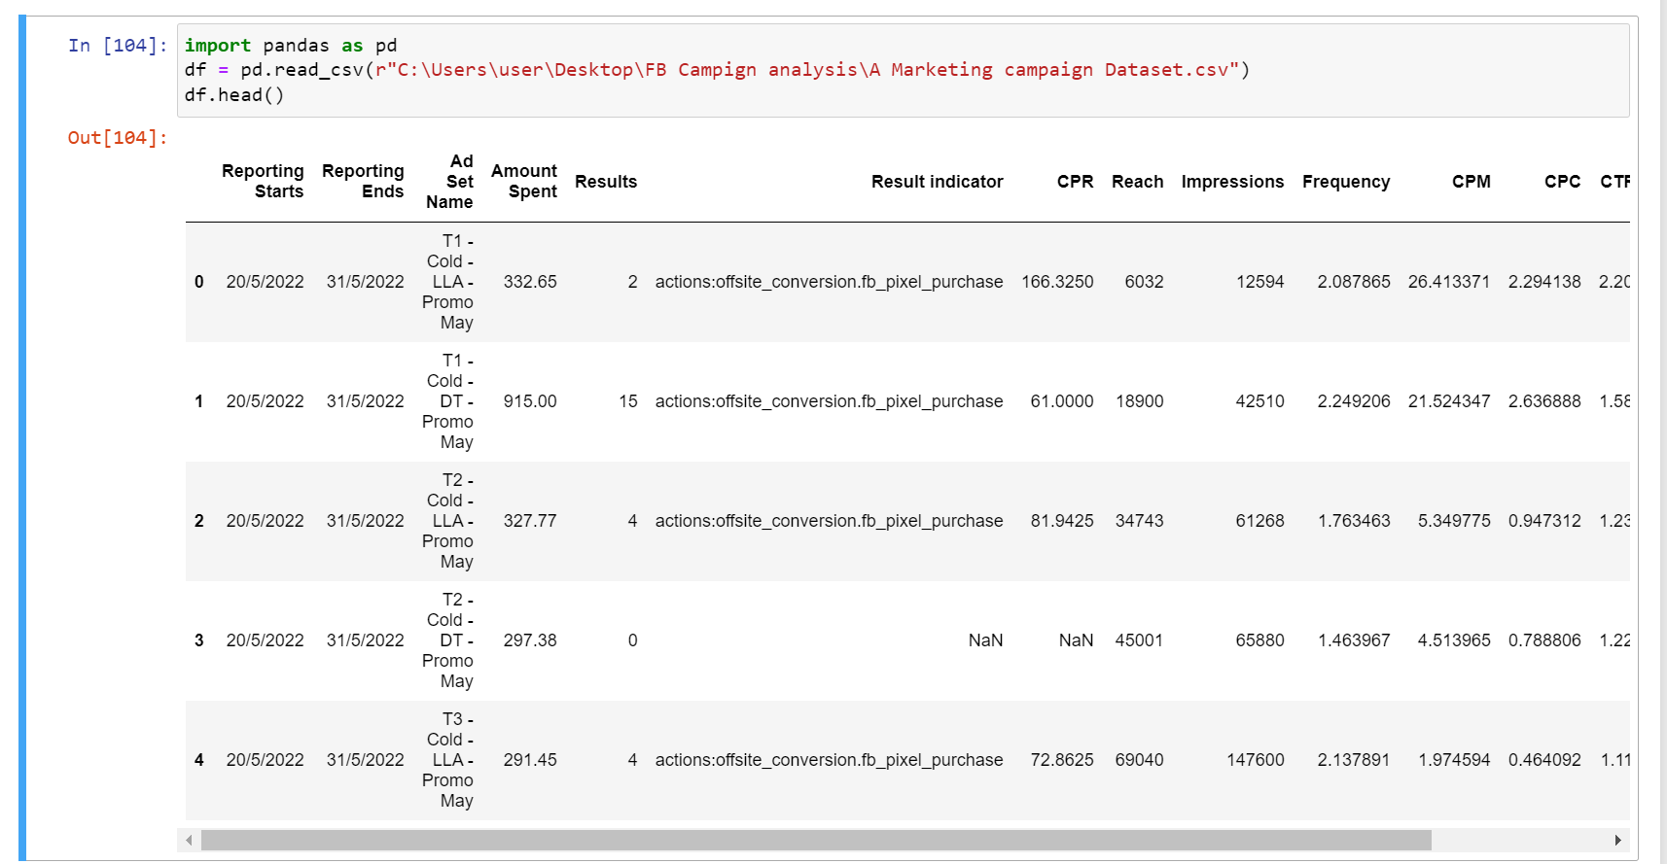

Slide 8
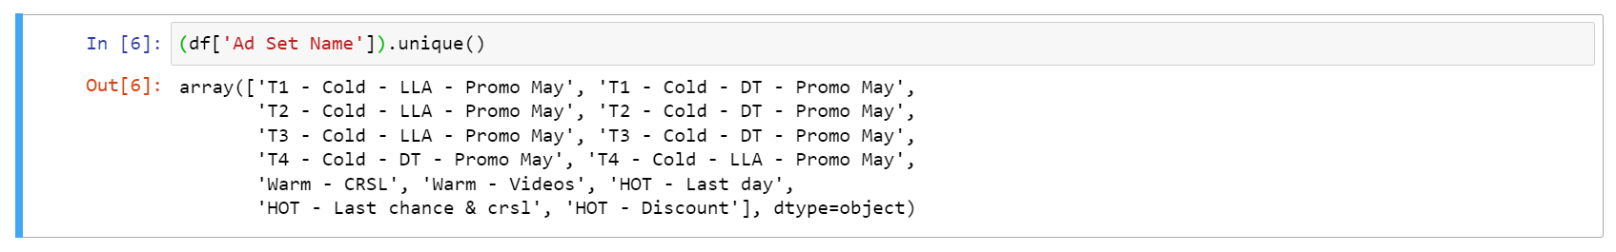
Ad Set Overview
Cold, Warm, and Hot ad sets
Lookalike & Detailed Targeting in Cold ad set
T1, T2, T3, and T4 in Cold Ad set
CRSL & Videos in Warm Ad set
Last chance, Discount, and Last day in Hot ad set

Slide 9
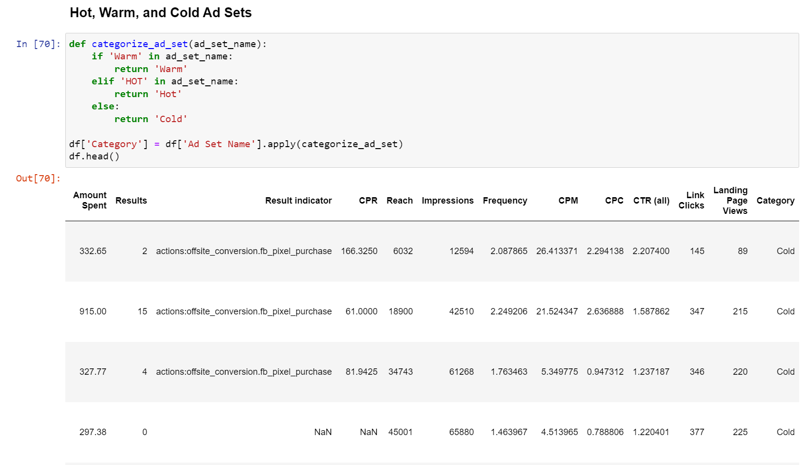
Creating a Category column for different ad sets

Slide 10
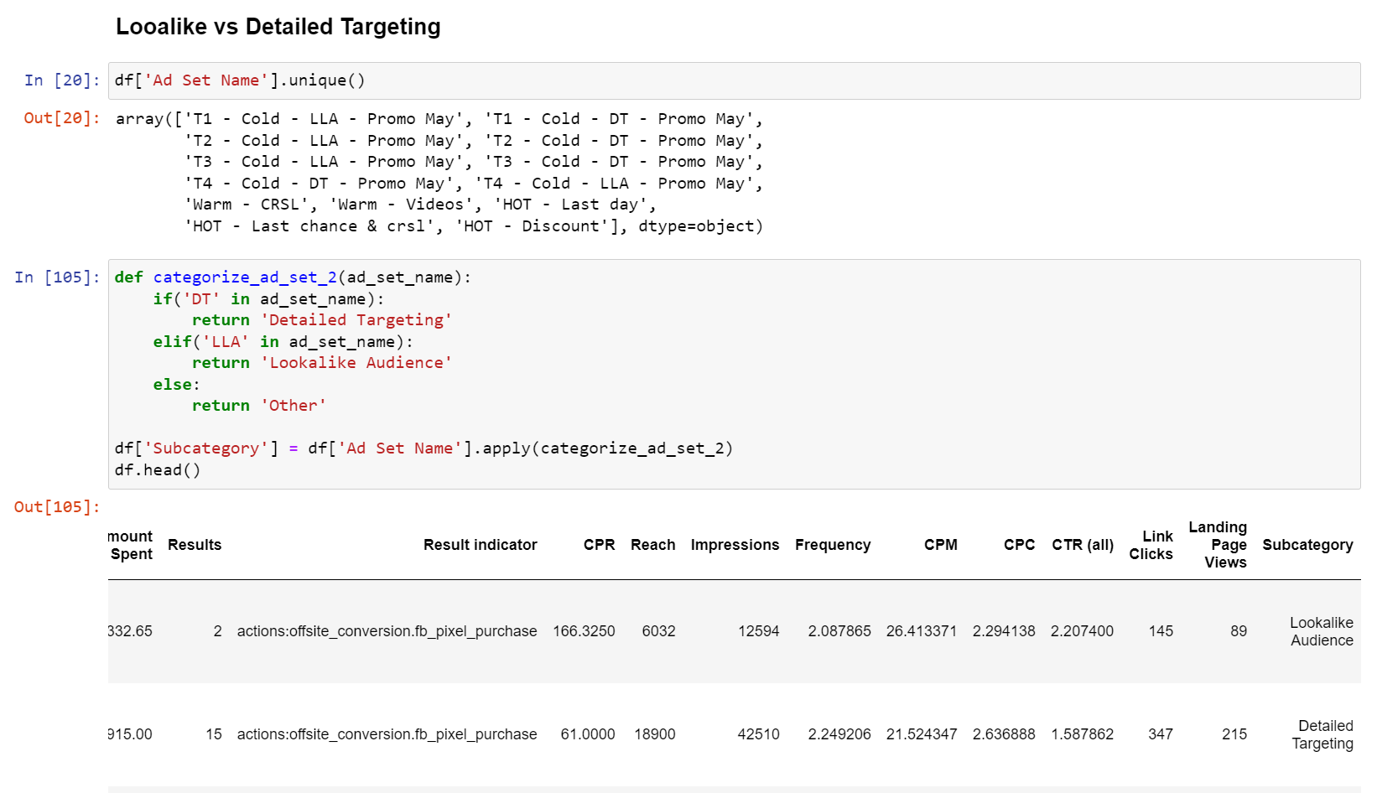
Creating a Sub-category column for different ad sets inside cold ad set

Slide 11
03
Campaign Highlights

Slide 12
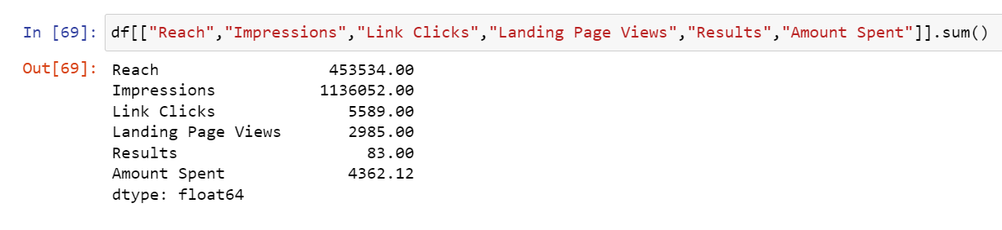
Campaign Highlights
We reached around 450K unique people.
Approx 1.1 million impressions.
Each person saw the ad around 2.5 times.
Approx 5.6K link clicks and 2.9K landing page views.
Total of 83 results.
Spent 4,362 EUR.

Slide 13
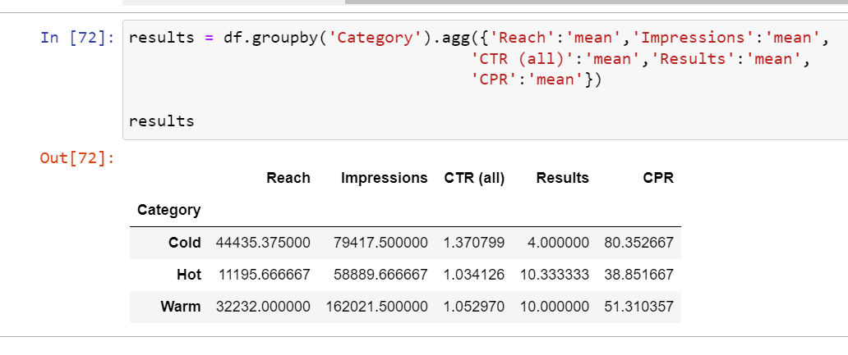
Aggregating all metrics based on the Category
Reach:
Cold ad set has the highest reach, indicating success in reaching a broad audience.
Impressions:
Warm ad set generates the highest impressions, surpassing Cold, despite a smaller reach.
CTR (Click-Through Rate):
Cold ad sets show higher CTR, possibly due to less familiarity with the company's content.
Hot and Warm Performance:
Hot and Warm ad sets perform the best, aligning with expectations of higher familiarity and conversion likelihood.
CPR (Cost Per Result):
Hot ad set has the lowest CPR, indicating cost-effectiveness, likely due to a closer audience ready for purchase as they are more familiar.

Slide 14
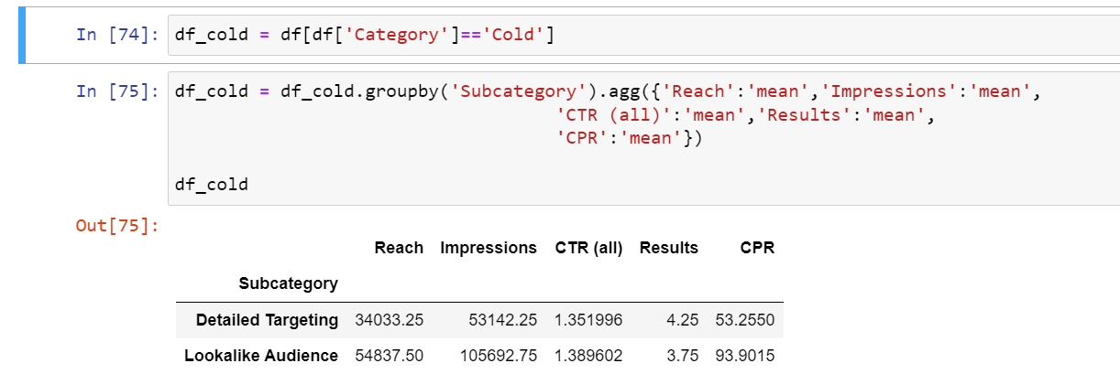
Aggregating all metrics based on the Sub-Category

Slide 15
03
Lookalike vs Detailed Targeting

Slide 16
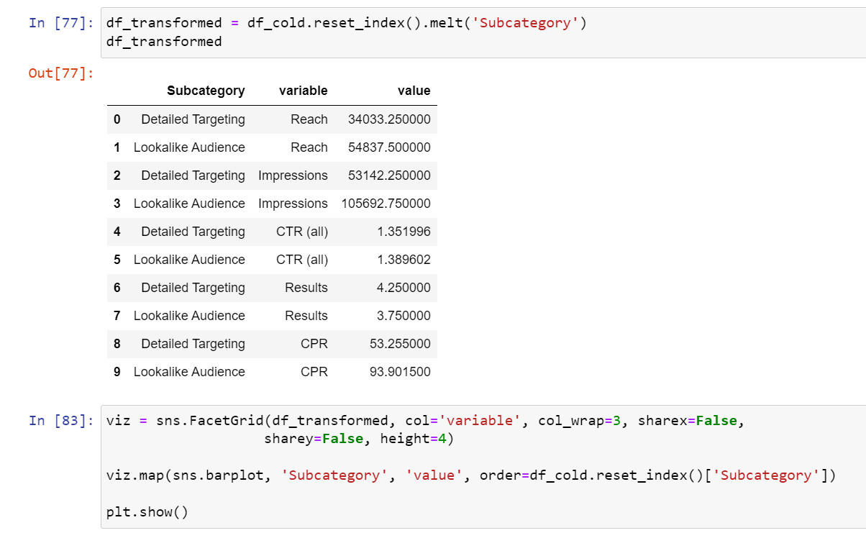
Unpivoting metrics and putting them in bar plots

Slide 17
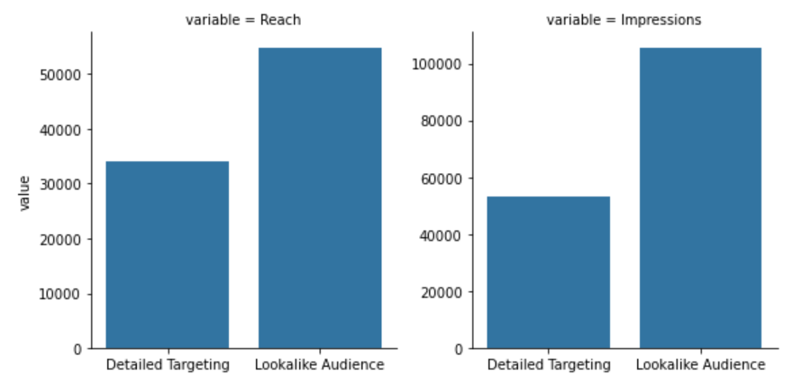
The Bar Plots
Lookalike vs. Detailed Audiences:
Lookalike audience has higher reach and impressions compared to the Detailed audience, as Lookalikes resemble a similar bas as the existing audience.

Slide 18
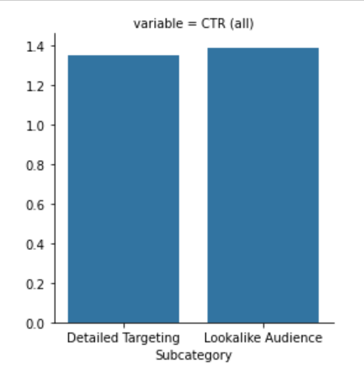
The Bar Plots
Impressions and reach:
Lookalike audience has higher reach and impressions compared to the Detailed audience, as Lookalikes resemble a similar bas as the existing audience.
CTR (Click-Through Rate) Equality:
No significant differences in CTR observed; both audiences engage equally with the content.

Slide 19
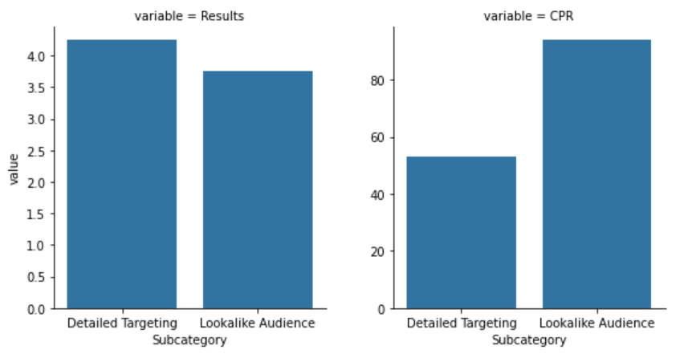
The Bar Plots
Results (Conversions) and Cost Per Result:
Detailed audiences achieve more results (conversions) than Lookalike.
Detailed audiences have a lower cost for conversions compared to Lookalike.
Conclusion:
Lookalike audiences are more extensive, suitable for brand awareness campaigns.
Detailed audiences, despite being smaller, are more likely to convert, making them ideal for conversion-focused campaigns.

Slide 20
04
Various Funnel Metrics Analysis

Slide 21
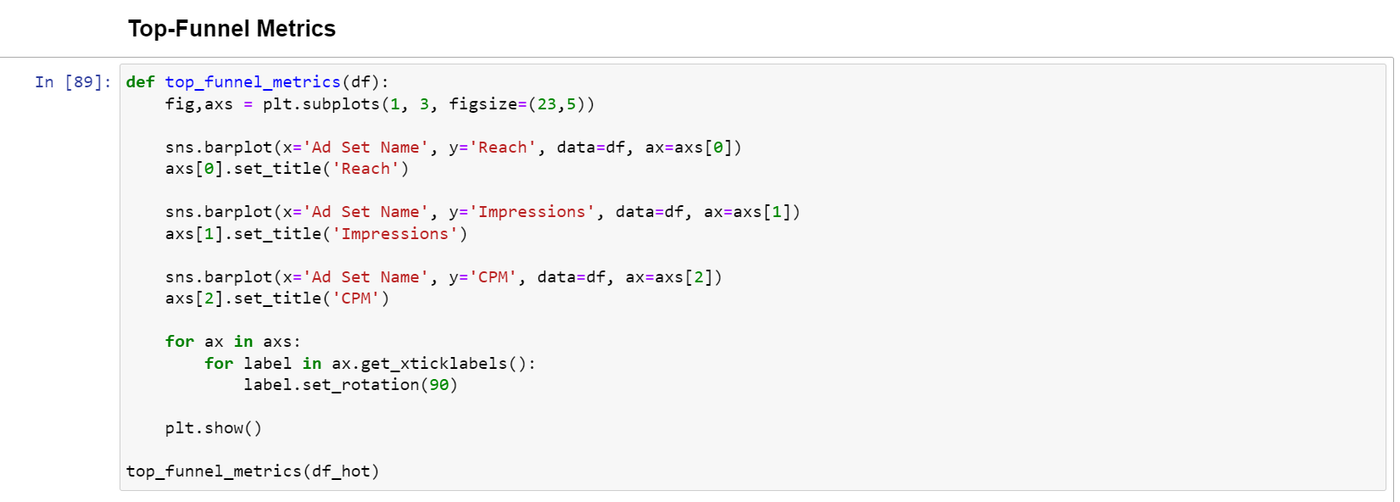
Analysis of Hot Ad Sets

Slide 22
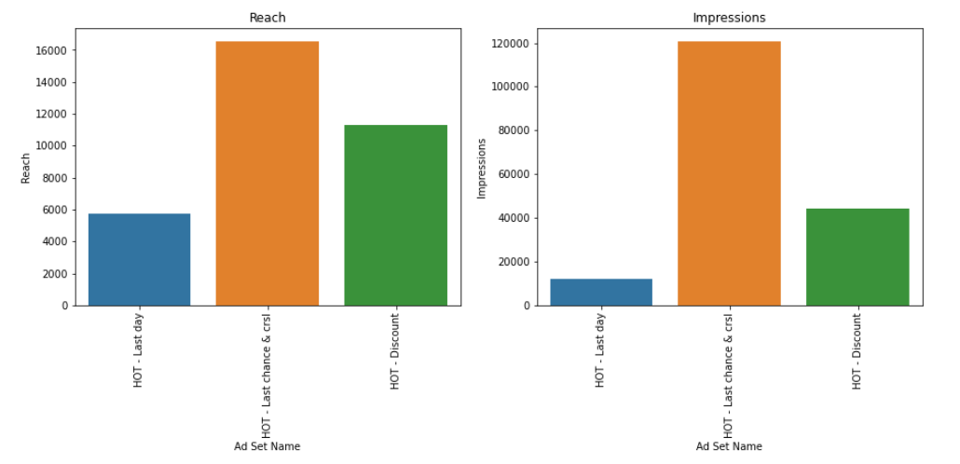
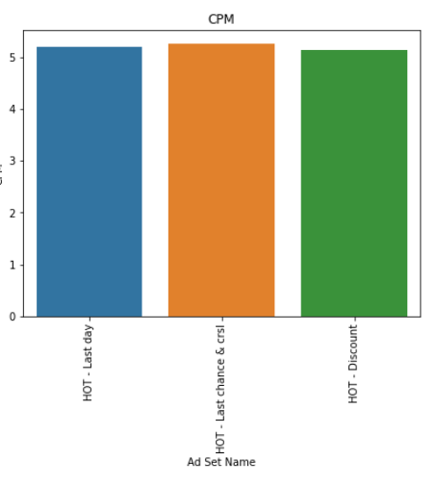
The Bar Plots (Hot ad set (Top funnel Metric)
Impressions and reach:
This ad set (Last - Chance & Crsl) outperforms others with higher reach and impressions, indicating a wider user reach.
CTR (Click-Through Rate) Equality:
All three ad sets exhibit similar costs per 1000 impressions, suggesting no significant cost differences among them.

Slide 23
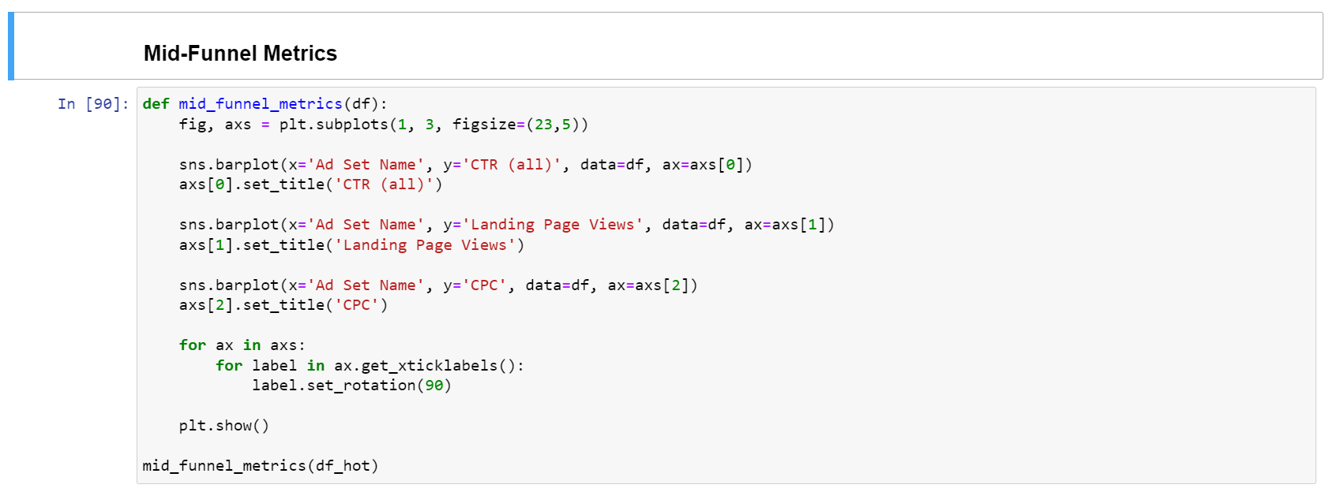
Analysis of Hot Ad Sets

Slide 24
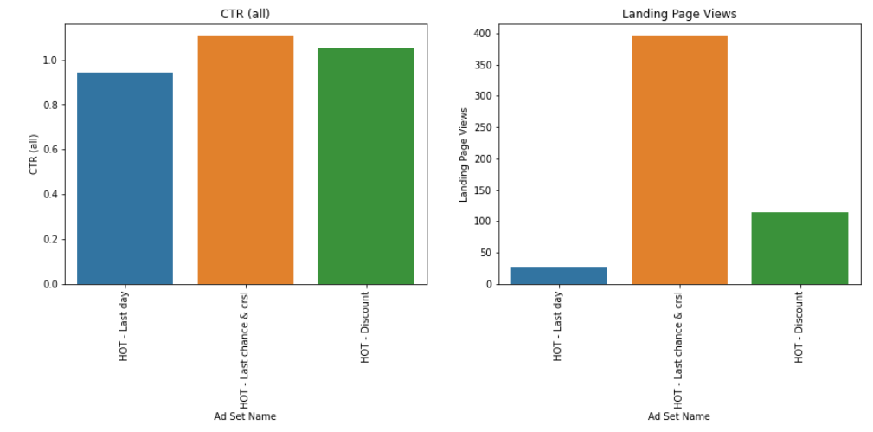
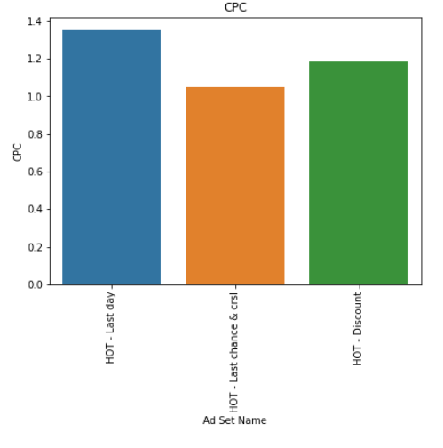
The Bar Plots (Hot ad set (Middle funnel Metric)
Hot Ad Set (Last - Chance & Crsl):
Hot ad set (Last - Chance & Crsl) shows higher CTR and views with low CPC which means more engaging users.

Slide 25
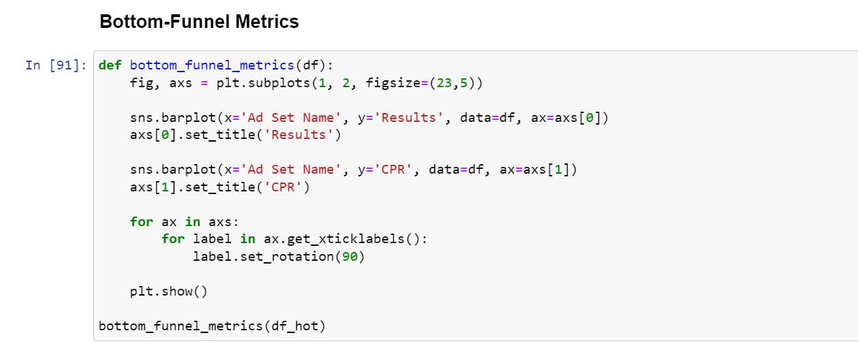
Analysis of Hot Ad Sets

Slide 26
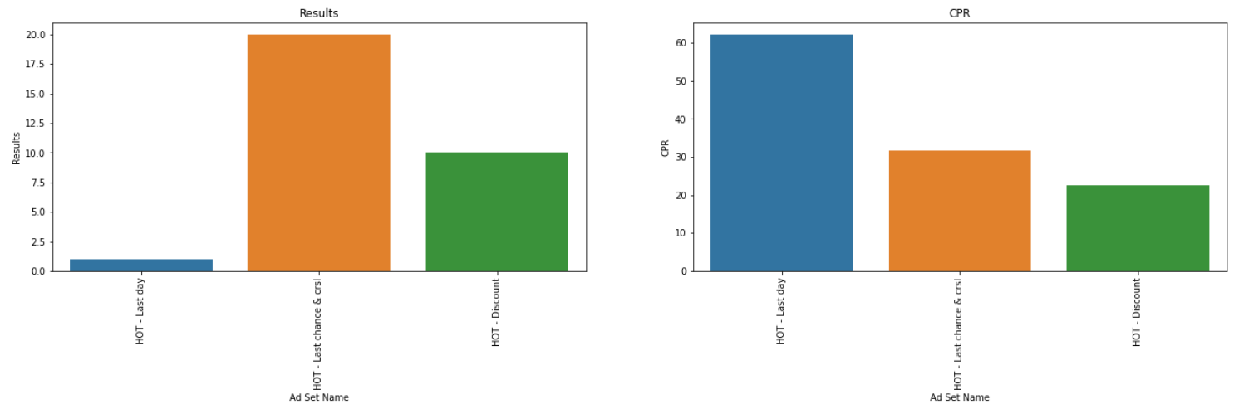
The Bar Plots (Hot ad set (Bottom funnel Metric)
(Last - Chance & Crsl) and Discount ad sets
(Last - Chance & Crsl) achieves higher results but has a higher CPR (Cost Per Result) at 31 Euro.
Discount ad set is more cost-effective with a CPR of 22 Euro, making it cheaper for obtaining results.
Hot - Last Day Ad Set:
Last Day ad set performs poorly with fewer results and the highest CPR, indicating it might not be as effective in achieving desired outcomes compared to other Hot ad sets.

Slide 27
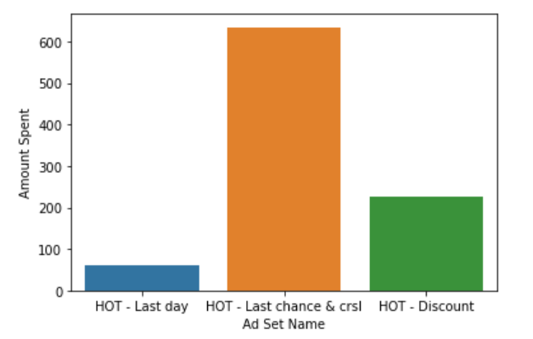
The Bar Plots (Hot ad set (Bottom funnel Metric)
Ad Set Spending and Cost Per Result (CPR):
The company spent around 600 Euro on Hot (Last - Chance & Crsl).
(Last - Chance & Crsl) has a higher overall cost than Hot - Discount, which had an expenditure of around 210 Euro.
Despite the lower spending, Hot - Discount is more cost-effective, with a lower cost per result.
Suggesting it might be advisable to allocate more budget to this Hot – Discount Ad set set for potentially better results at a lower cost per outcome.

Slide 28
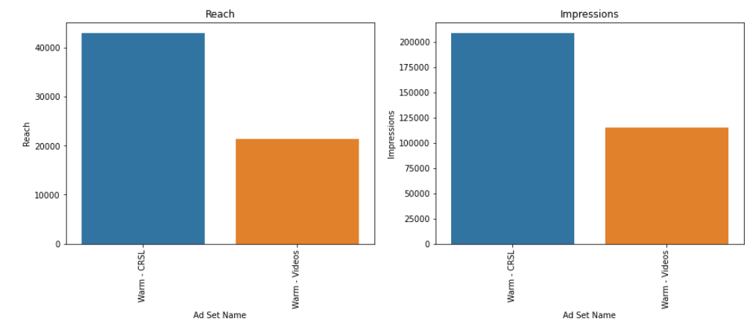
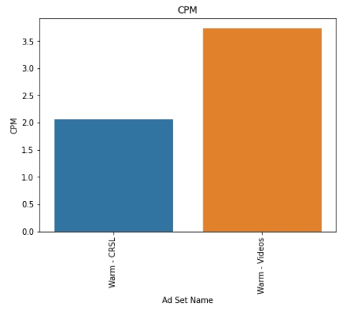
Analysis of Warm Ad Sets
The Bar Plots (Warm ad set (Top funnel Metric)
Warm Ad Sets Comparison (CRSL and Videos):
The CRSL ad set outperforms the Videos ad set in terms of reach, impressions, and CPM (Cost Per Mille).
CRSL reaches more users and generates more impressions, making it a more impactful ad set in terms of audience engagement and visibility.

Slide 29
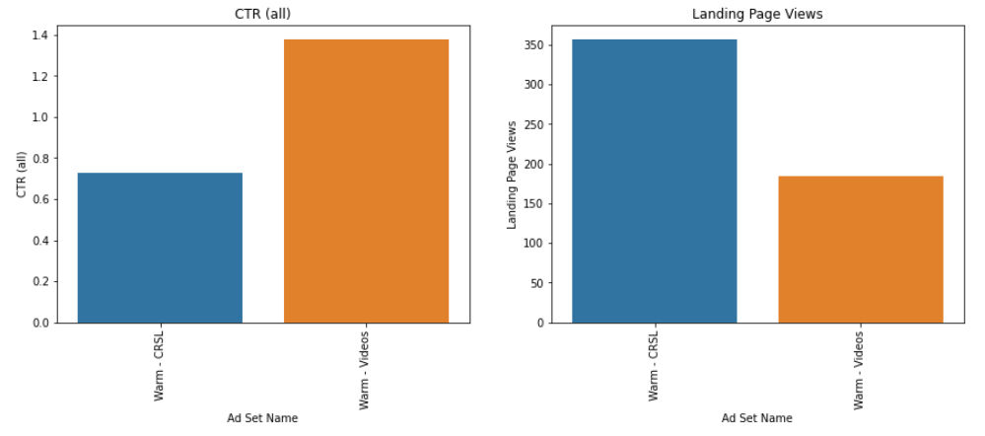
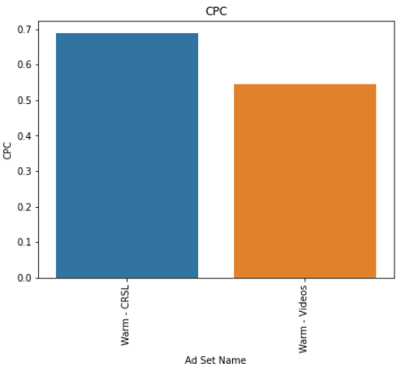
The Bar Plots (Warm ad set (Middle funnel Metric)
Video Ad Set:
Higher Click-Through Rate (Clicks per Impressions).
Less Page views.
Lower Cost Per Click.
Page Views Concern:
Video ad set has fewer page views, although having higher CTR.
Potential issue with page loading, indicating a need for investigation for page loading problem to enhance user experience.

Slide 30
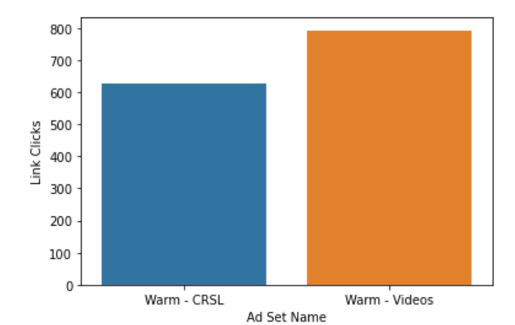
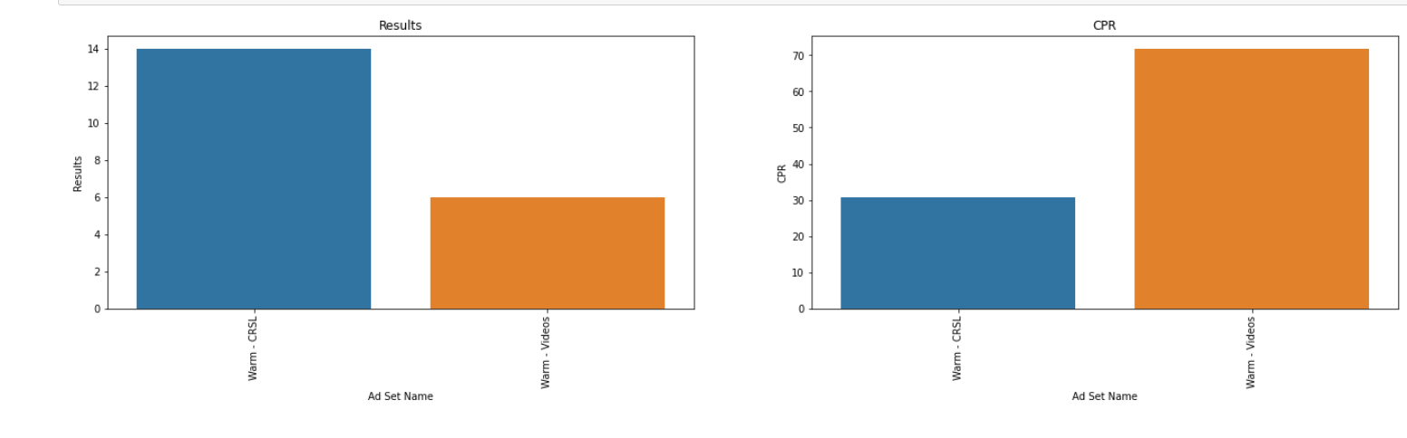
The Bar Plots (Warm ad set (Bottom funnel Metric)
CRSL Ad Set:
Achieves significantly higher results.
Lower Cost Per Result (CPR).
Issue with Videos Ad Set:
Large drop-off between link clicks and page views in the Videos ad set.
Potential obstacle for conversions, as users may face difficulties reaching the company's website.

Slide 31
Thanks!

